Slide 2
Component 1 – Art and Design
Level 5

Slide 3
Candidate 1
Art and Design – Level 1
AO1 | AO2 | AO3 | AO4 | Total
14 | 14 | 15 | 14 | 57
Examiner comment:
AO1: Mostly confident and assured ability – Level 5
AO2: Mostly confident and assured ability – Level 5
AO3: Fully confident and assured ability – Level 5
AO4: Mostly confident and assured ability – Level 5
Total of 57 marks overall.

Slide 4
57 marks

Slide 5
57 marks

Slide 6
57 marks

Slide 7
57 marks

Slide 8
57 marks

Slide 9
57 marks

Slide 10
57 marks

Slide 11
57 marks

Slide 12
57 marks

Slide 13
57 marks

Slide 14
57 marks

Slide 15
57 marks

Slide 16
57 marks

Slide 17
57 marks

Slide 18
57 marks

Slide 19
57 marks

Slide 20
57 marks

Slide 21
57 marks

Slide 22
57 marks

Slide 23
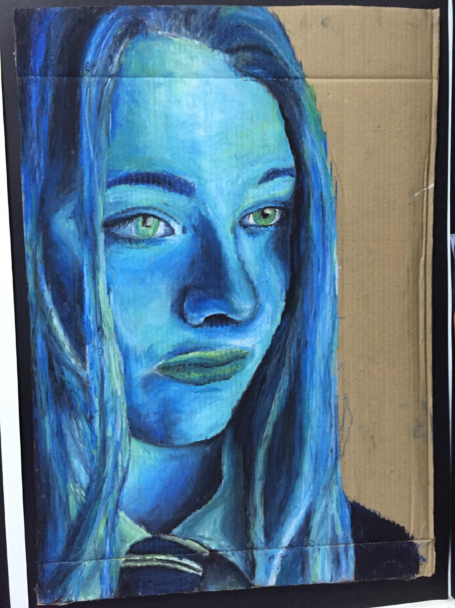
57 marks

Slide 24
57 marks

