Slide 2
Component 1 – Fine Art
Level 6

Slide 3
Candidate 1 Fine Art – Level 6
AO1 | AO2 | AO3 | AO4 | Total
16 | 16 | 16 | 16 | 64
Examiner comment:
AO1: Just exceptional ability – Level 6
AO2: Just exceptional ability – Level 6
AO3: Just exceptional ability – Level 6
AO4: Just exceptional ability – Level 6
Total of 64 marks overall.

Slide 4
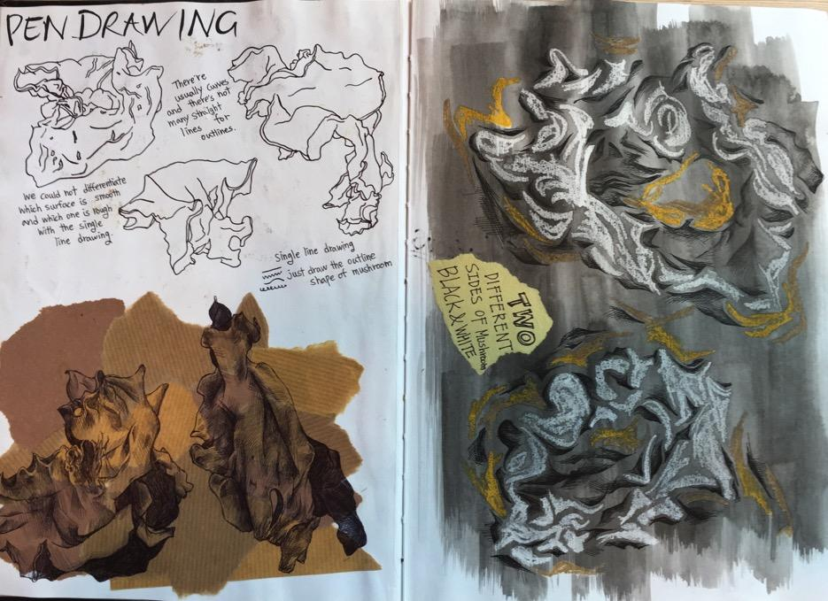
64 marks

Slide 5
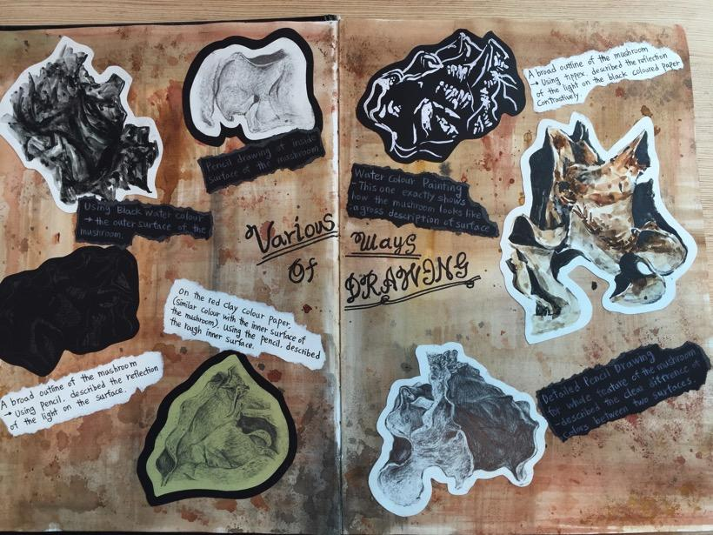
64 marks

Slide 6
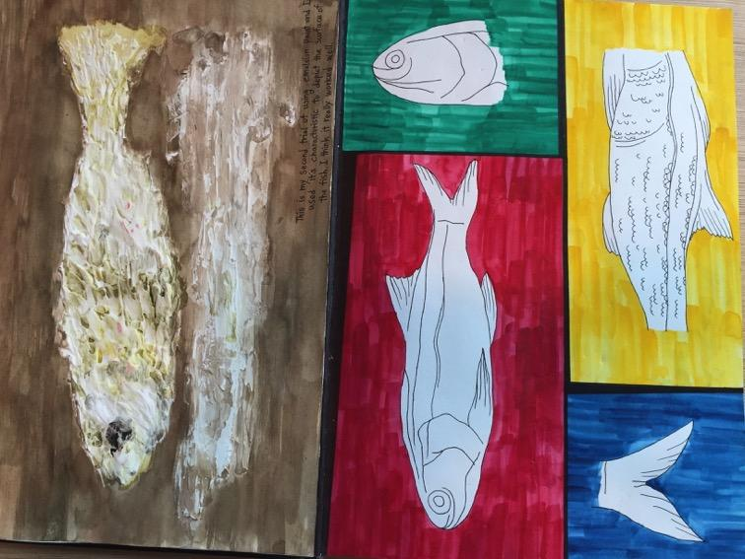
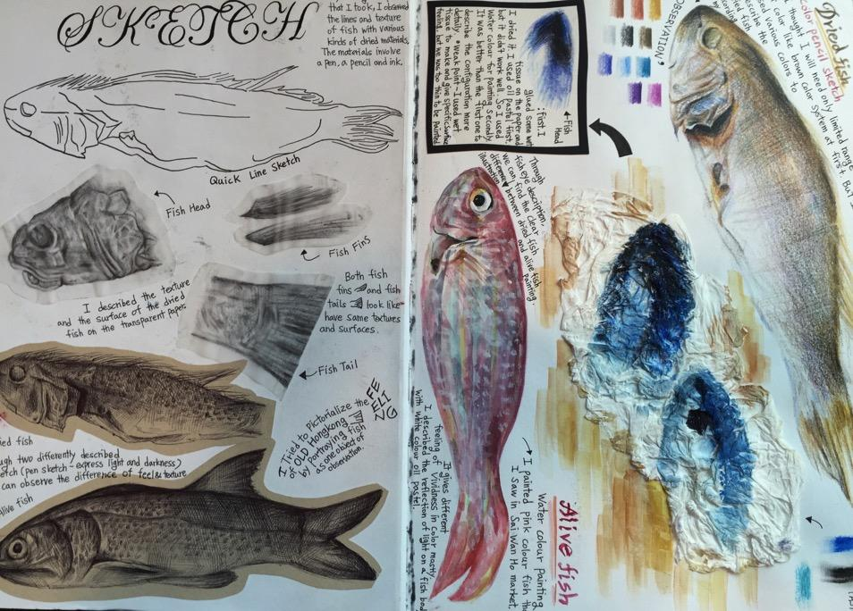
64 marks

Slide 7
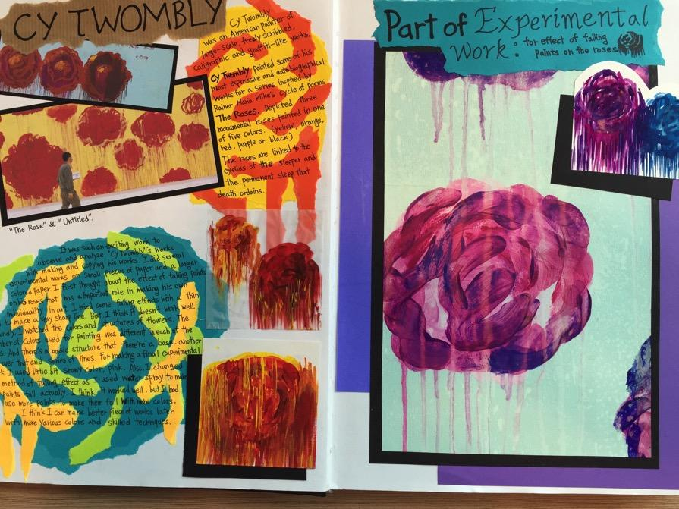
64 marks

Slide 8
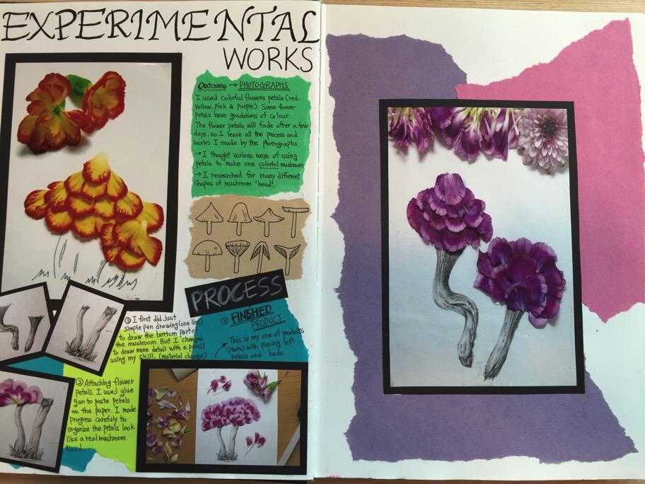
64 marks

Slide 9
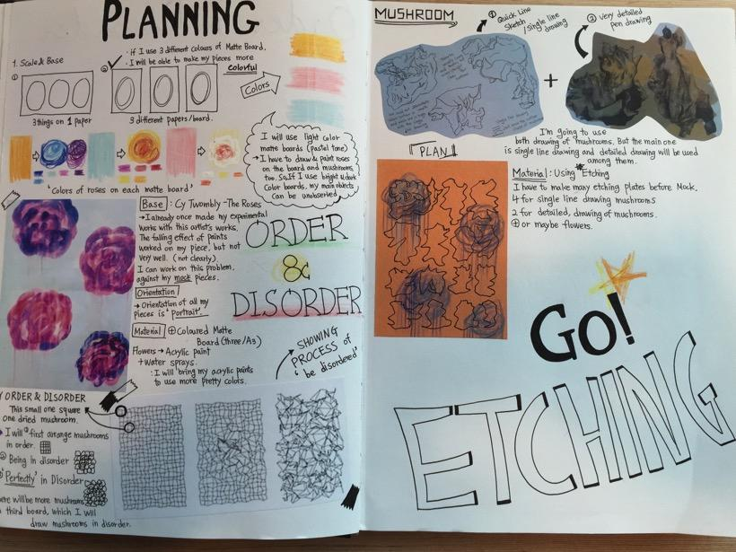
64 marks

Slide 10
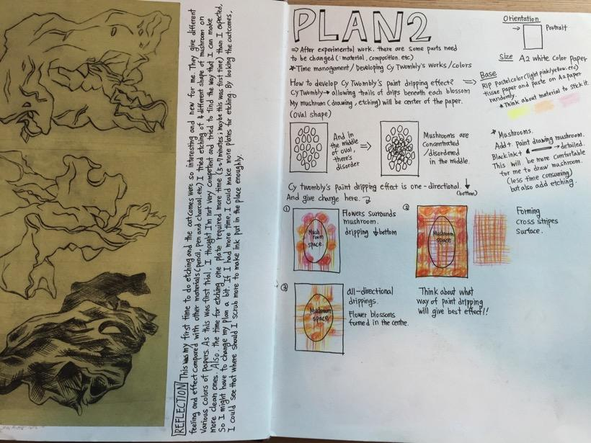
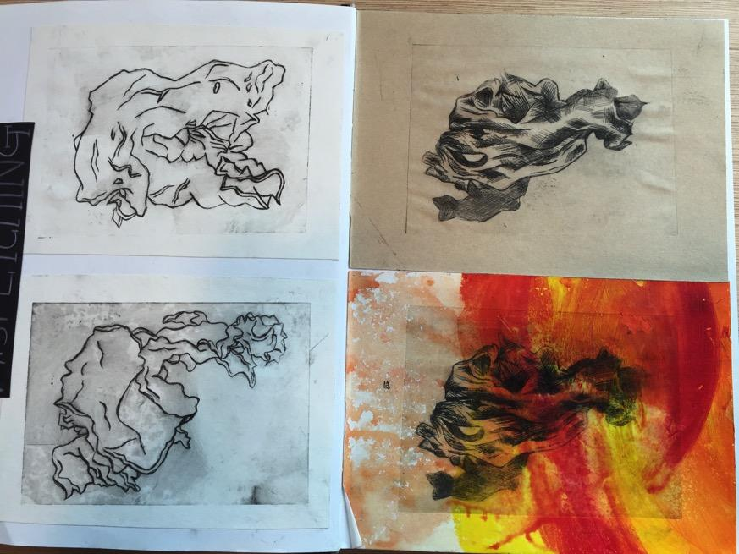
64 marks

Slide 11
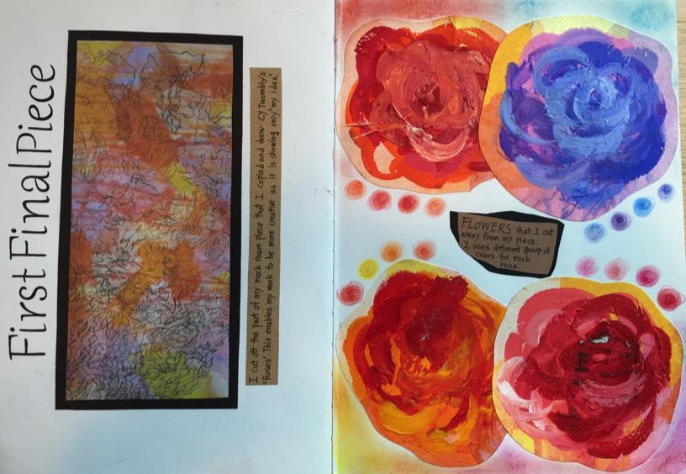
64 marks

Slide 12
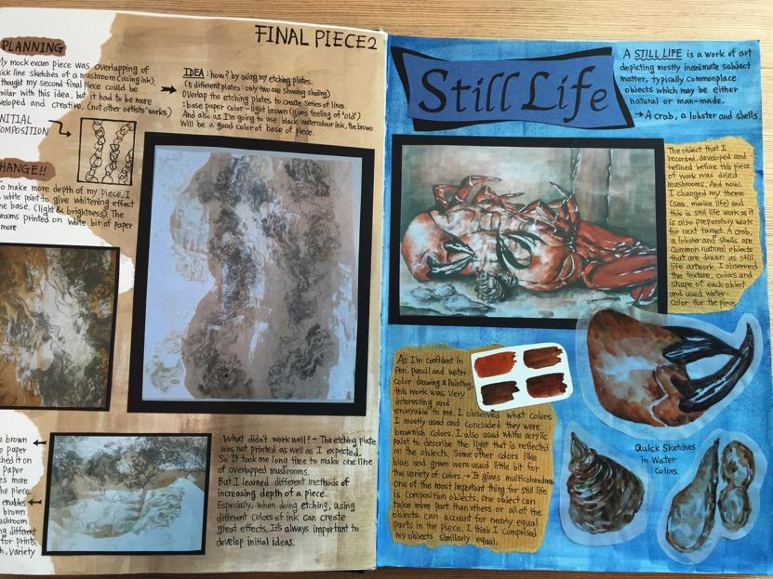
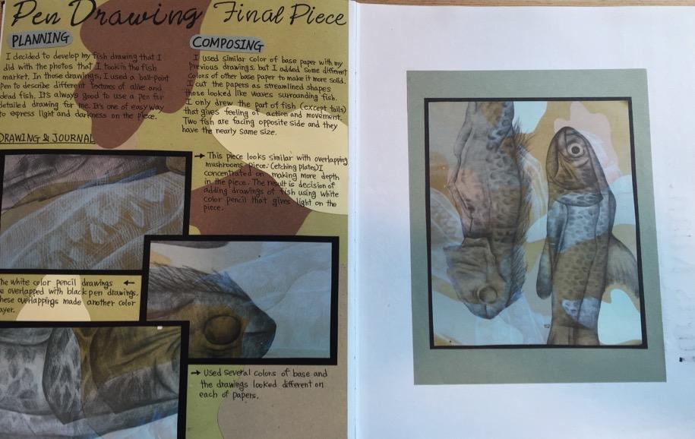
64 marks

Slide 13
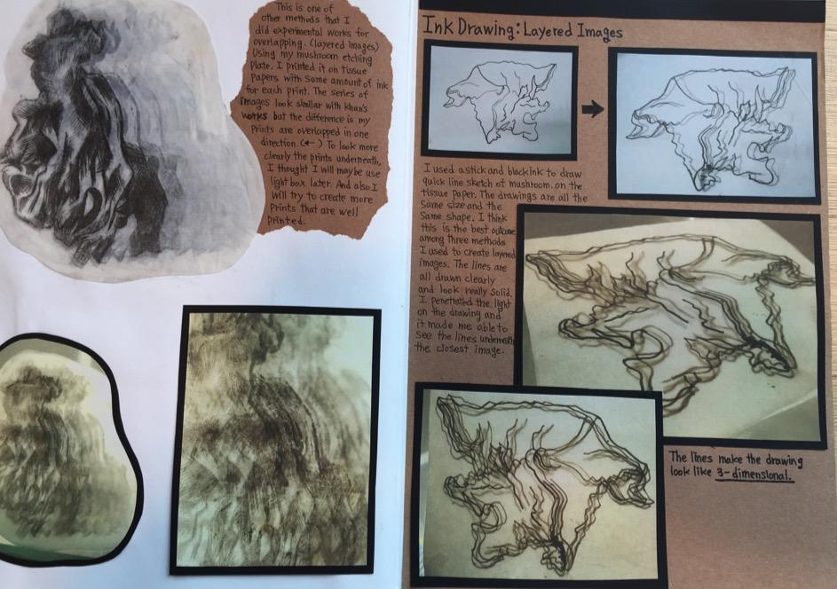
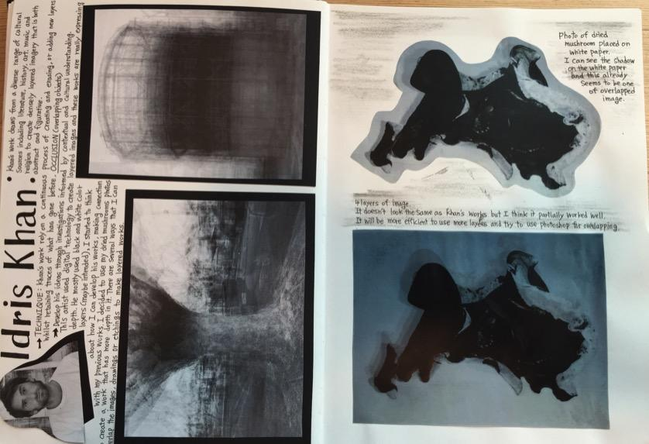
64 marks

Slide 14
64 marks

Slide 15
64 marks

Slide 16
64 marks

Slide 17
64 marks

Slide 18
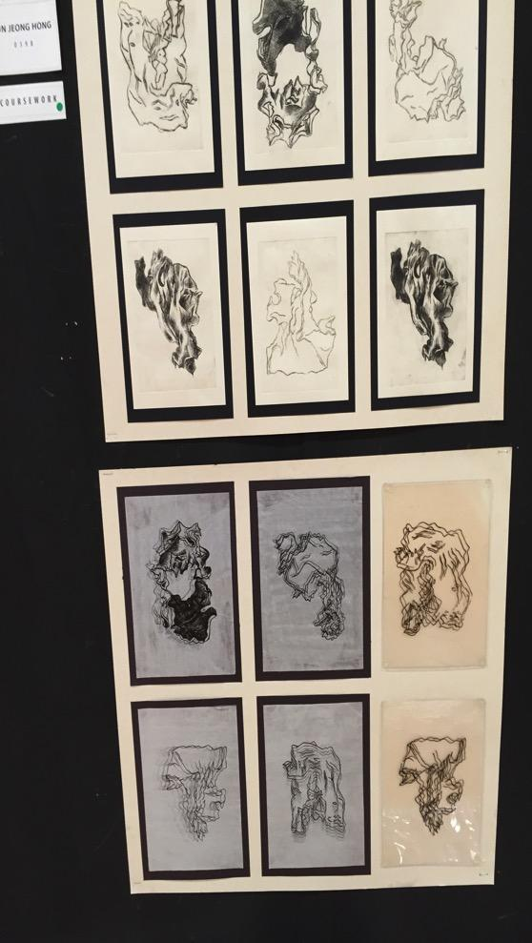
64 marks

Slide 19
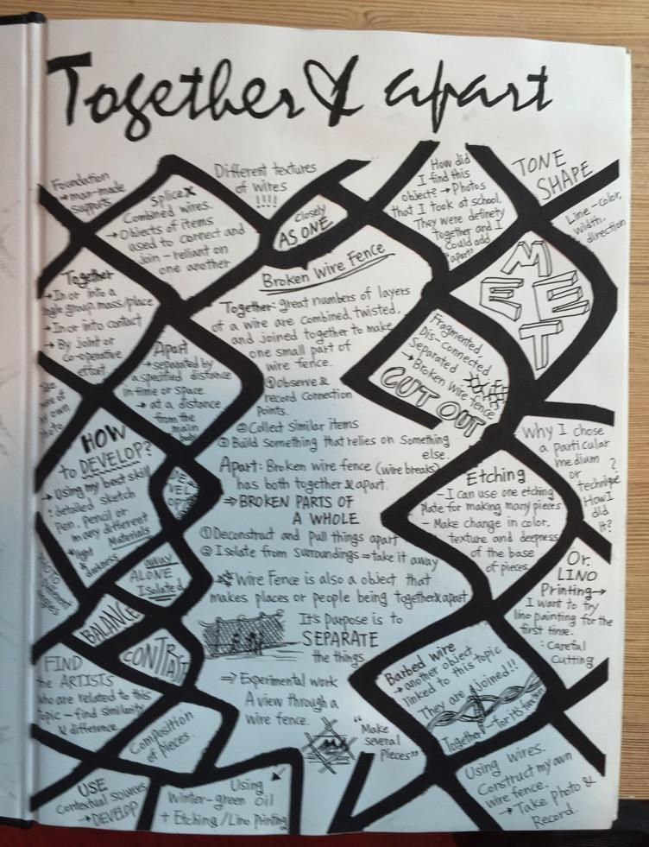
64 marks

Slide 20
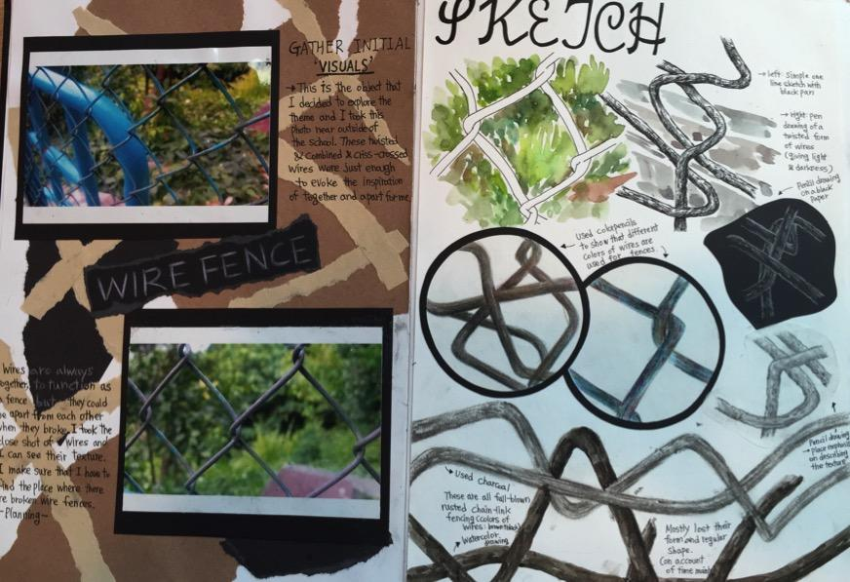
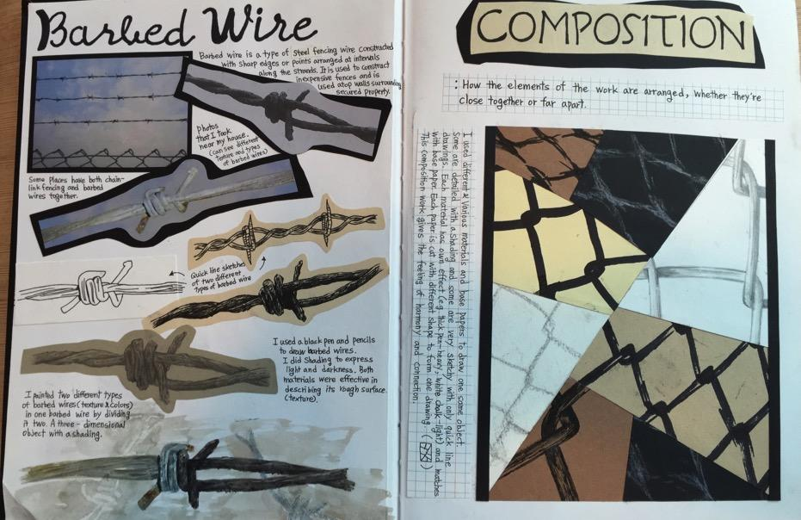
64 marks

Slide 21
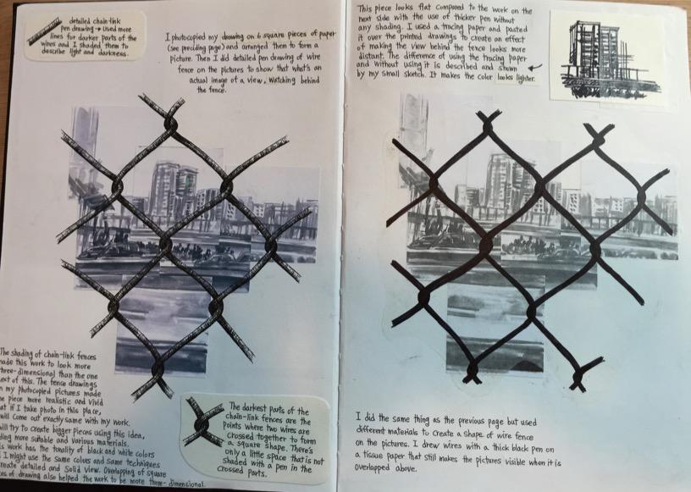
64 marks

Slide 22
64 marks

Slide 23
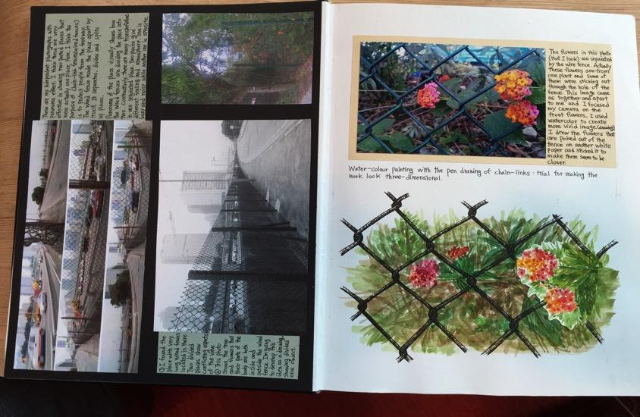
64 marks

Slide 24
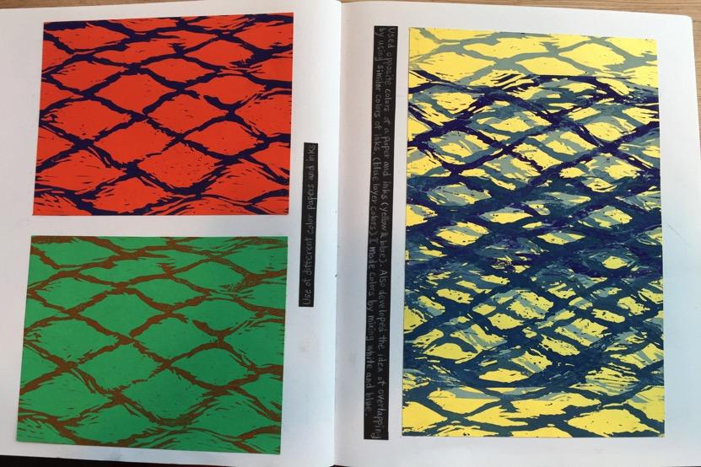
64 marks

Slide 25
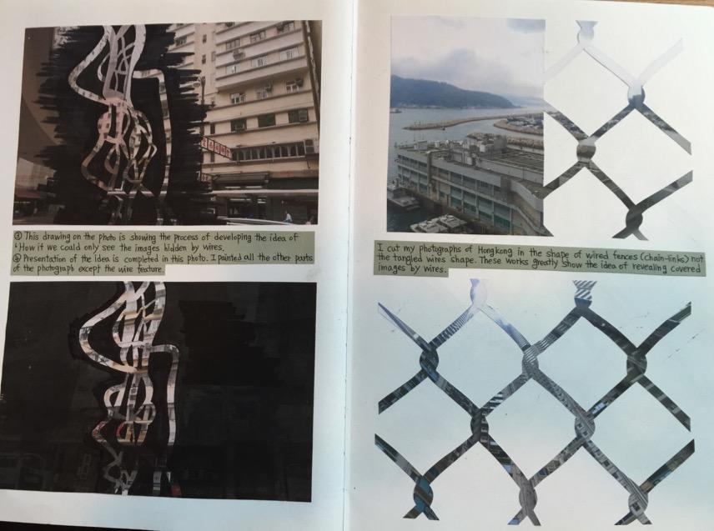
64 marks

Slide 26
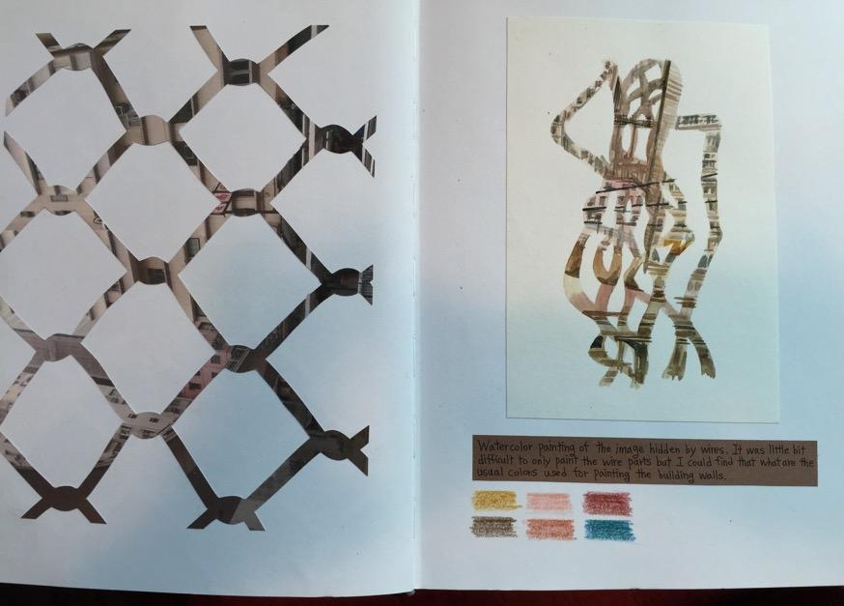
64 marks

Slide 27
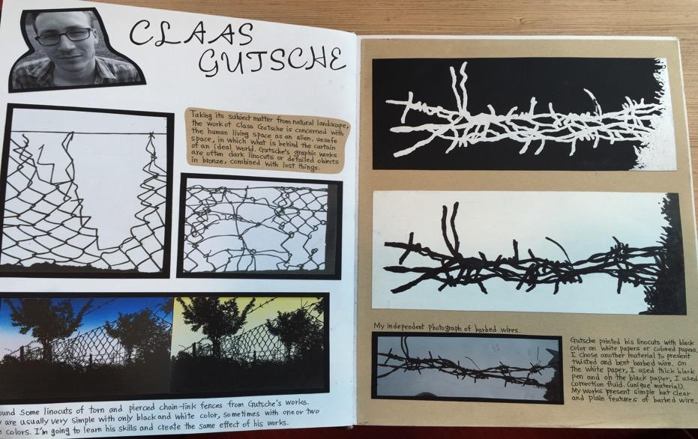
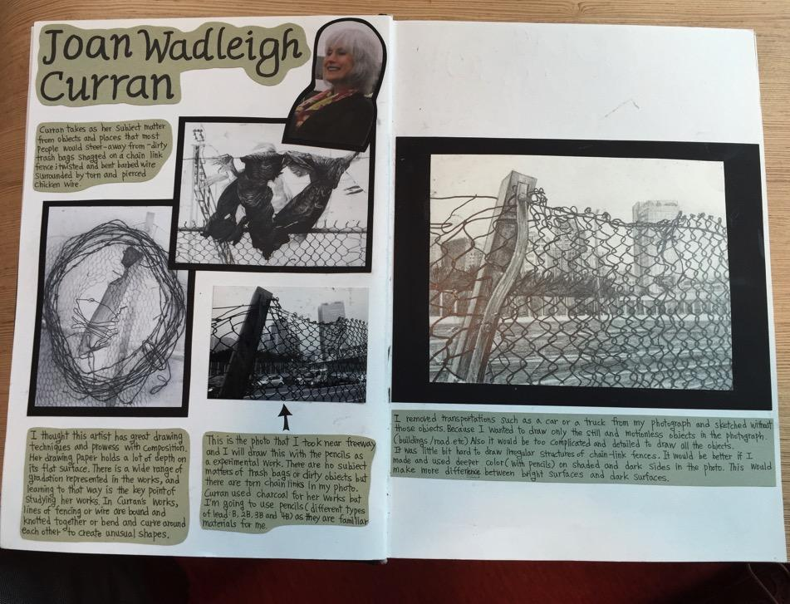
64 marks

Slide 28
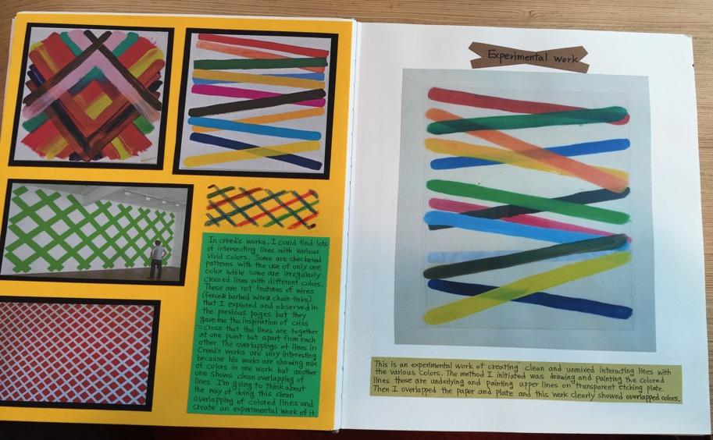
64 marks

Slide 29
64 marks

Slide 30
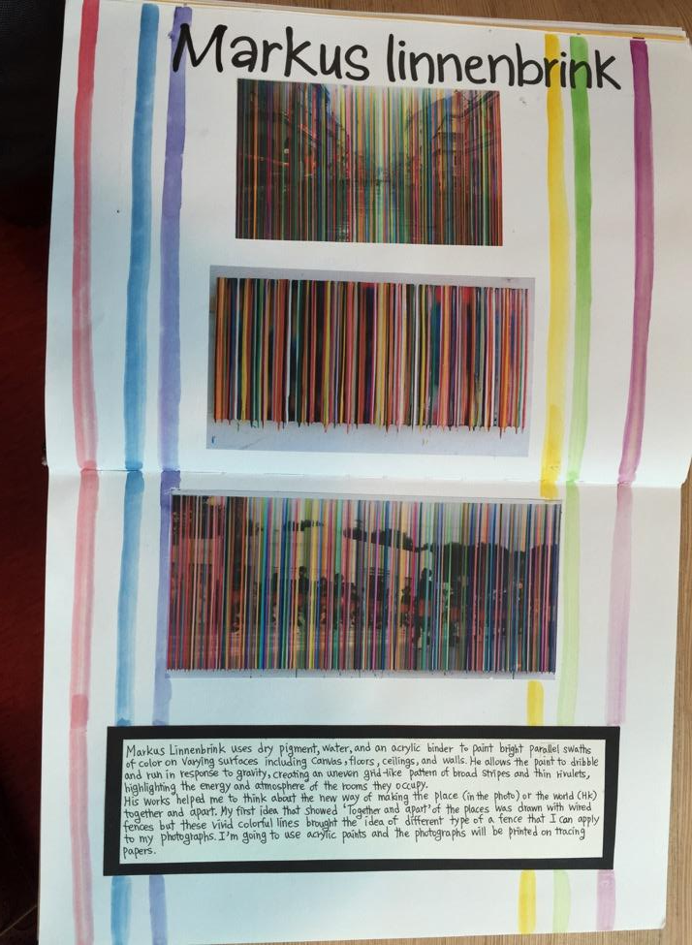
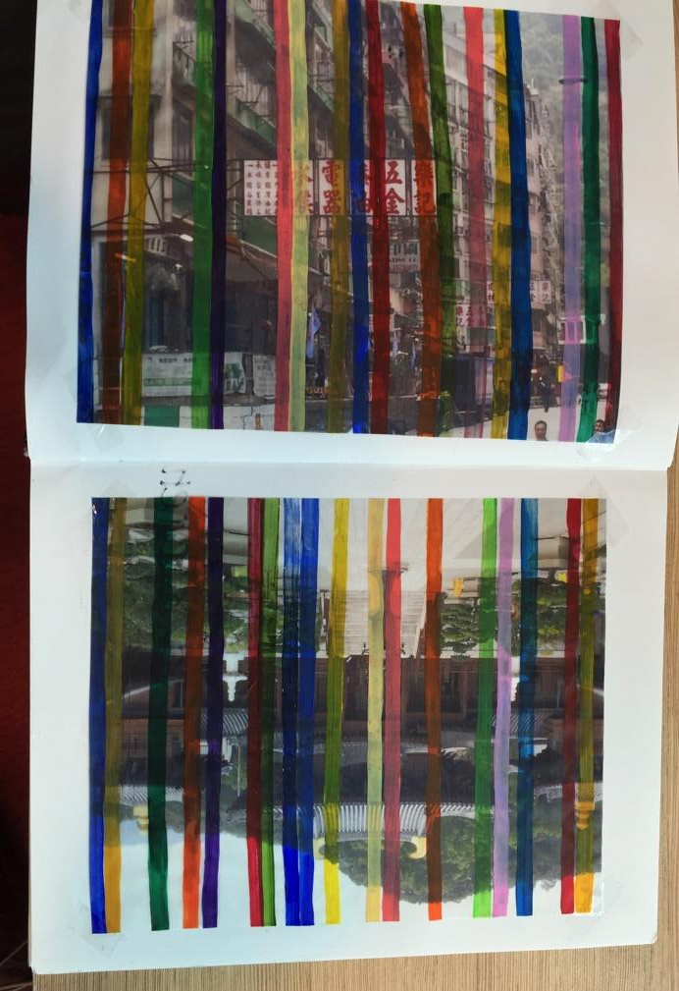
64 marks

Slide 31
64 marks

Slide 32
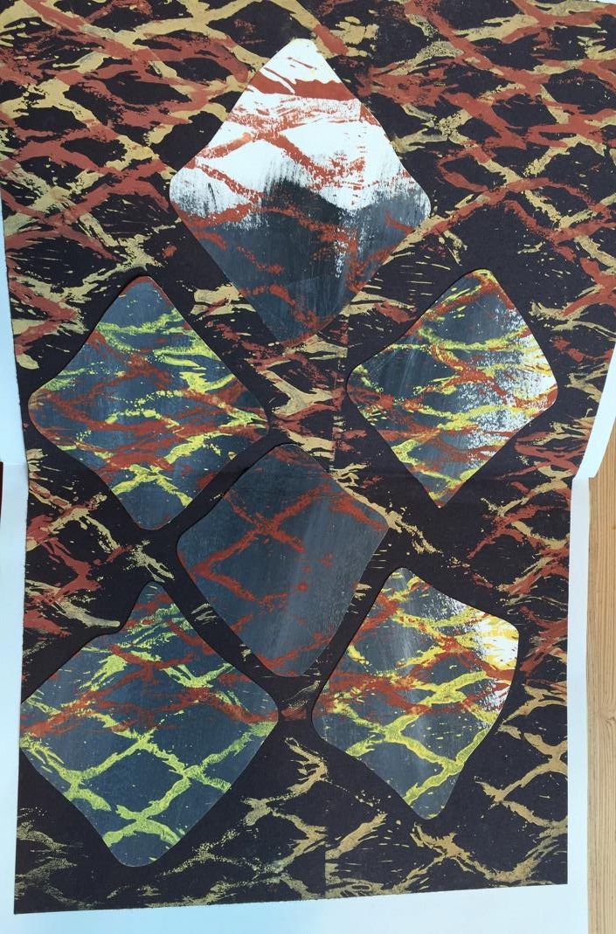
64
64 marks

Slide 33
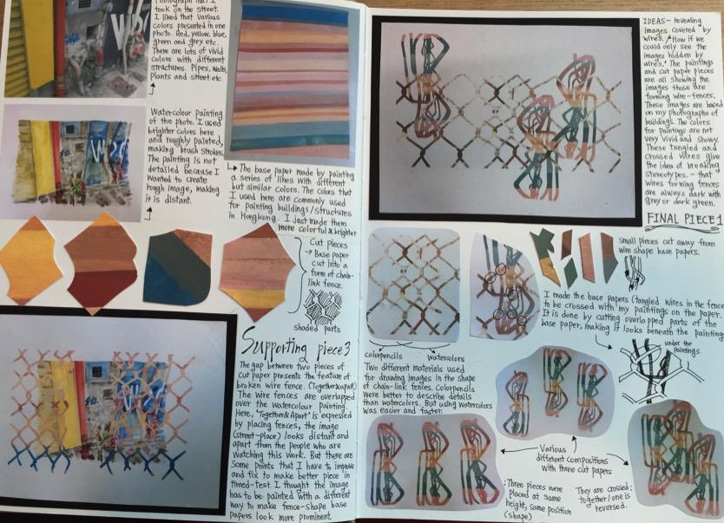
64 marks

Slide 34
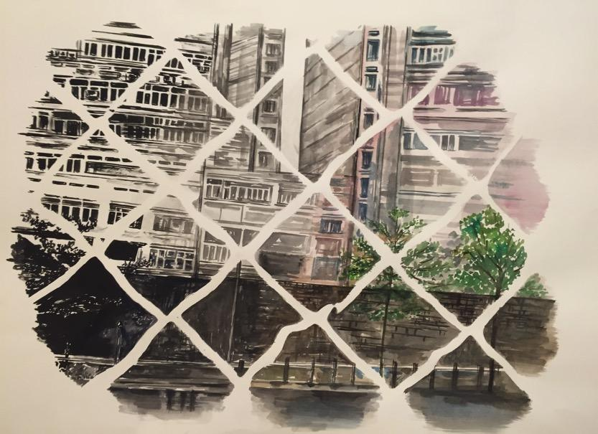
64 marks

Slide 35
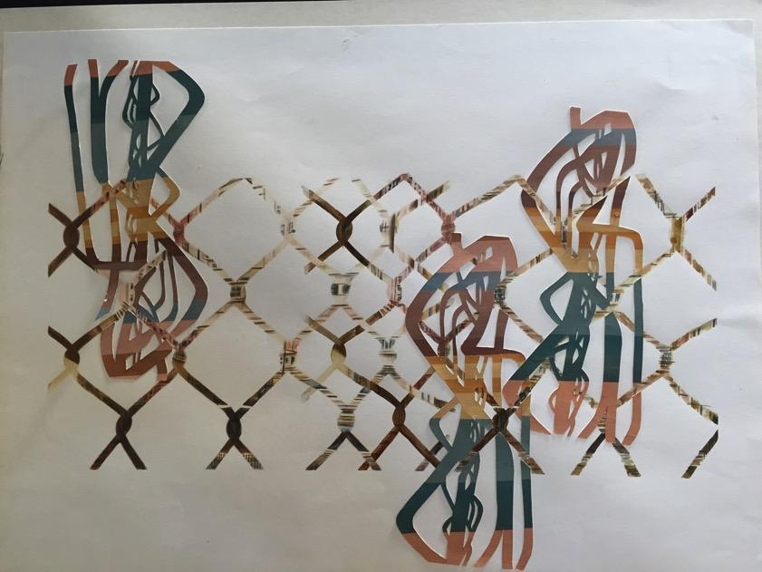
64 marks

Slide 36
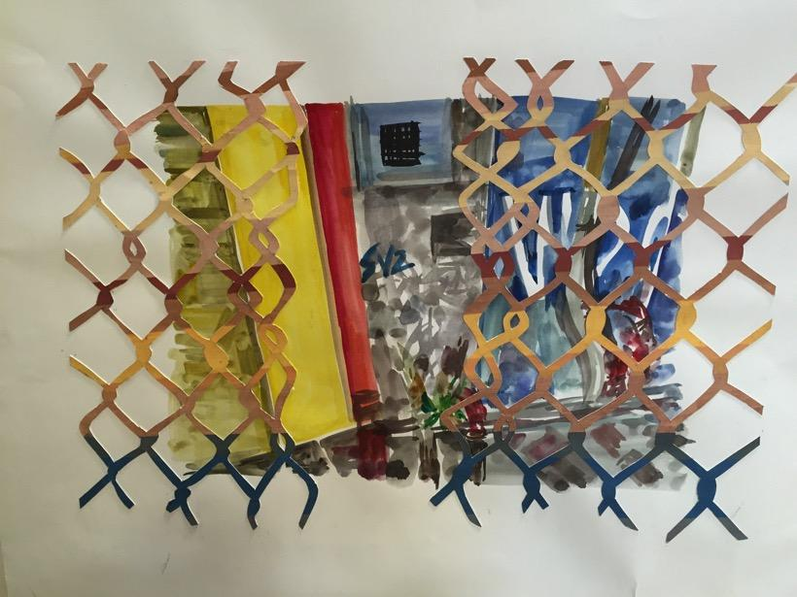
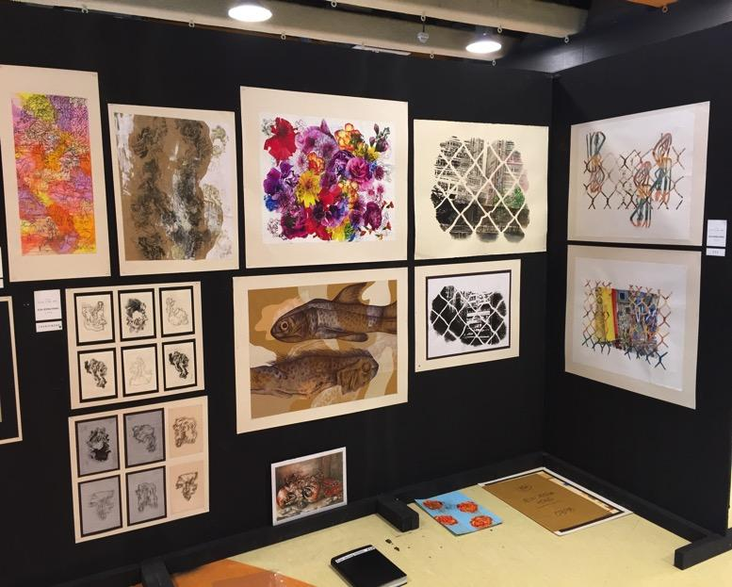
64 marks

